Slide 1

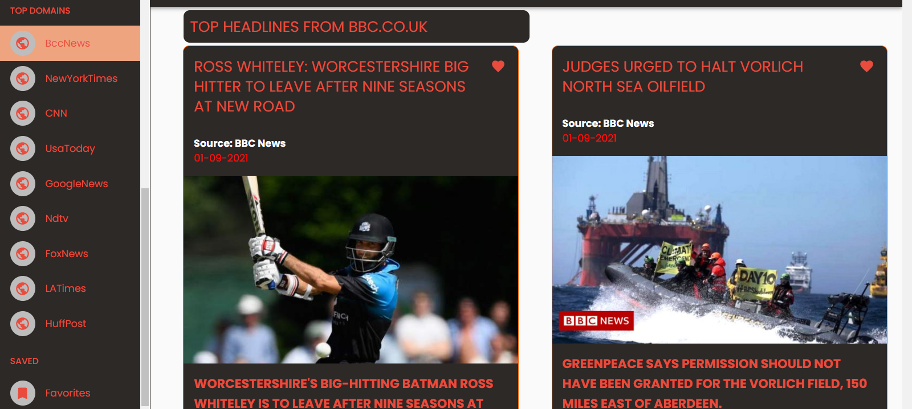

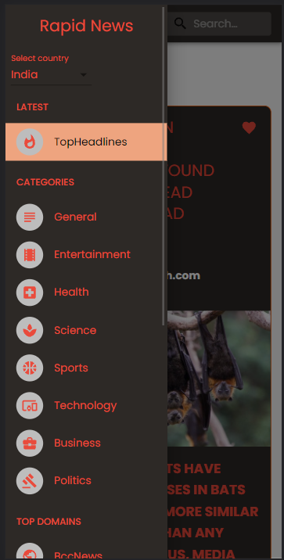
Rapid News
Web App
Mini Project Report
Under the Guidance of
Dr.B.Uma Maheswari(MSc,MCA,M.Phil,phD)
Assistant Professor
Department of Computer Applications
Submitted By
Manoj Kumar Ku
(19BCA024)

Slide 2
Abstract
Rapid News web-app is an web-app for reading global news
At this web-app, we will able to read the global news in short feeds .
The primary goal of the web-app is for offering global news from a different countries and domains.
Today Many people don’t have time to go through long news articles everyday. So we cut the clutter and deliver them, in 60-word shorts. Short news for the future generation.

Slide 3
Introduction
This project is aimed to delivers all articles less than 60-word short on online.
Through this application any person who need to read news feeds can read independent of time and different language and share with other users
The user can able to save their favourite feed , it will be available in the saved list every time .
If the user wants to read full articles that interested them , they can able to read it through its official site by redirection

Slide 4
Existing System
Usually people reads news feeds from only one Domain source
There will be some retardation for the search option
There will be more unwanted resources present in that sites , this will sometimes disturbs the readers
Lots of annoying advertisement which will pop up or it present in somewhere in the site ,it redirects the user to that webpage , there will be high risks of Malware attacks
Users cant able to save their favourites news

Slide 5
Proposed System
The users can able to search results from different domain sources
The users can able to get news from their desired country wise domains
Most of the contents present in this app is Official resources .
Most of the contents are Ad free contents.
Users can able to save their favourites news it will saved in their Browser

Slide 6

System Requirements
You should use the latest Google Chrome, Firefox, MS Edge, and Safari.
Your network connection should be at least 500 Kbps.

Slide 7

Hardware Requirements
Your network connection should be at least 500 Kbps.
Dual core 2.5ghz 1mb L2 cache (Intel or AMD)
2GB ram and high
P-IV Processor Or higher

Slide 8

Software Specifications
Operating System:Windows 10(64 Bit)
Language:React Js,Css,javascript,Html
Server: Node Package Manager [NPM]
TOOLS: VS Code,Chrome Browser

Slide 9


Software Description
Frontend:
React Js
React-Router
Material-UI
Saas
Awesome Loader
NPM(Node Package Manager)
Backend:
News API

Slide 10
Module Description
SYSTEM DESIGN
A module is a software component or part of a program that contains one or more routines.

Slide 11
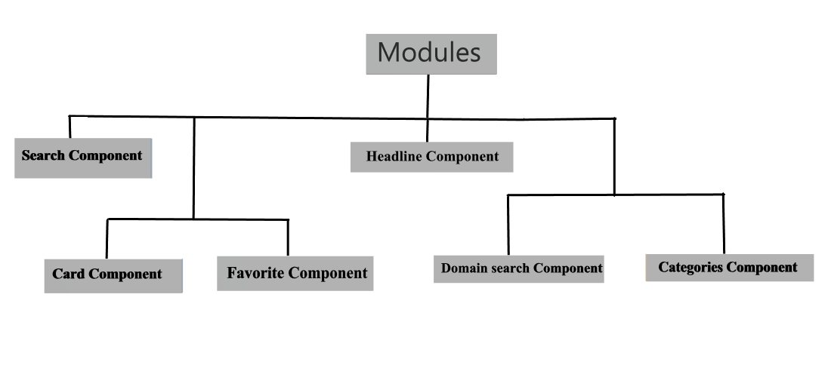

Module Description
Rapid News | To Spread the news to multiply it.

Slide 12
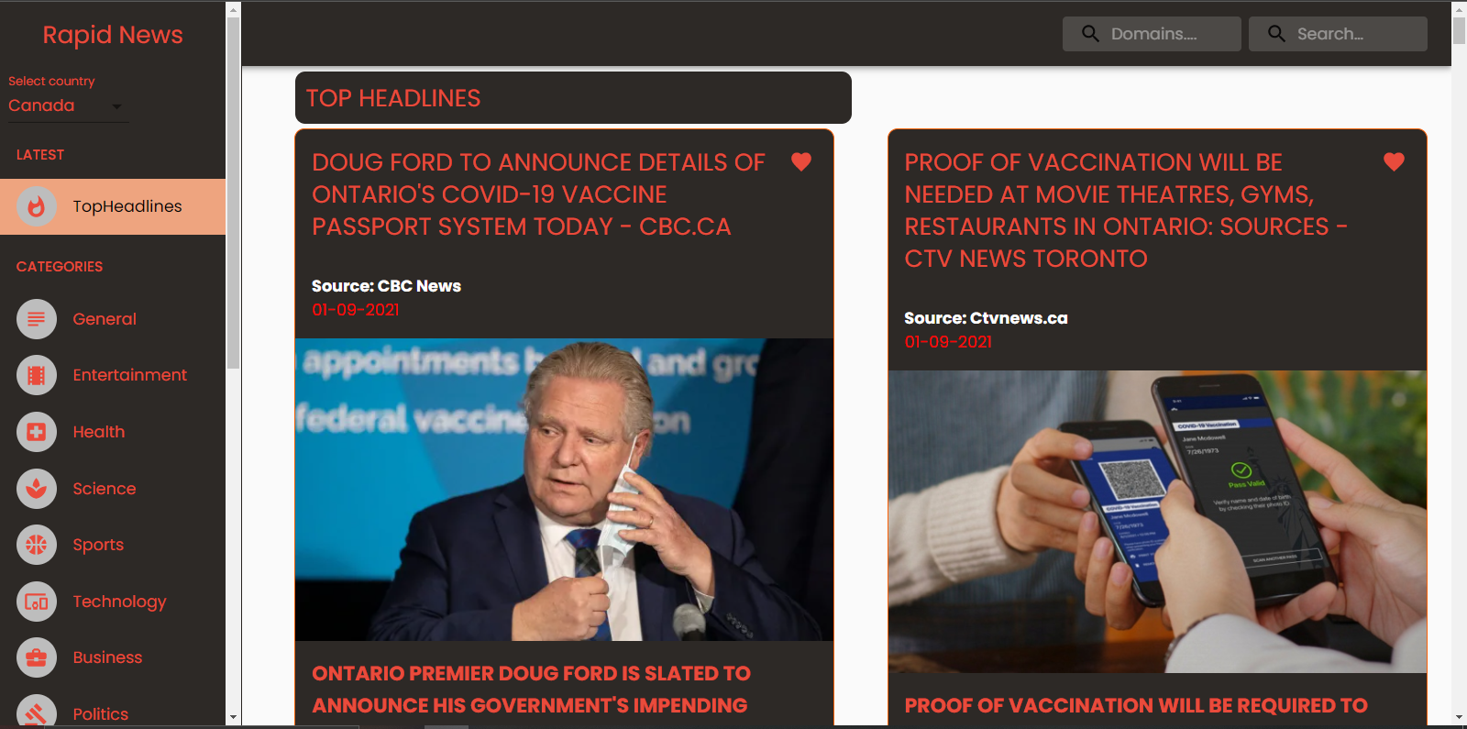
Headline Component
Headline Component provides live top and breaking headlines for a country, specific category in a country, single source, or multiple sources. Articles are sorted by the earliest date published first.
Rapid News | To Spread the news to multiply it.

Slide 13
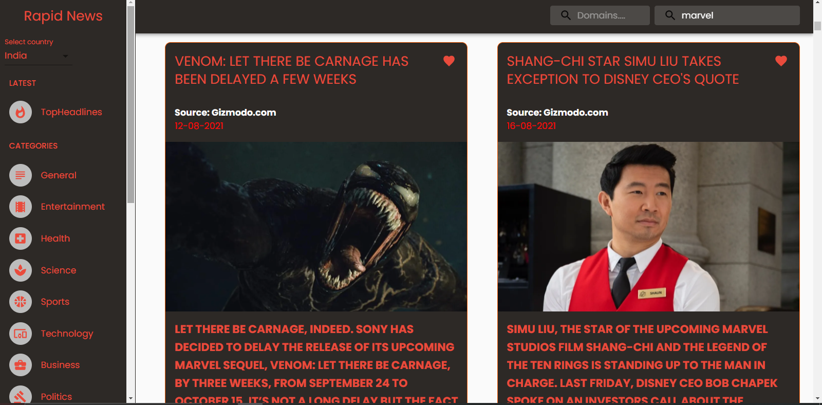
Search Component
Search component allows user to search news via queries in the search text box which brings the relevant information from the database ,which will be from the different sources of domains
Rapid News | To Spread the news to multiply it .

Slide 14


Card Component
Card Component is used to display the contents of the news in the website , so that the user can be able to see the content of the news like a feeds and also share their liked news feed ..Read full articles by clicking know more .Also save their desired news
Rapid News | To Spread the news to multiply it.

Slide 15
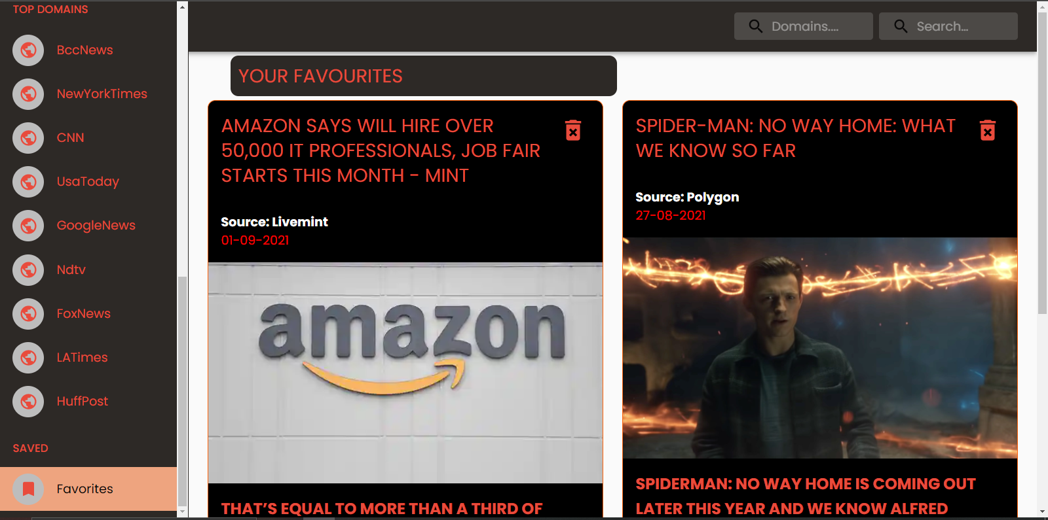
Favourite Component
In this module the user can view their favourite News , which will be stored in their browser local storage while they surfing through the different news from different categories and from different domains .
Rapid News | To Spread the news to multiply it

Slide 16

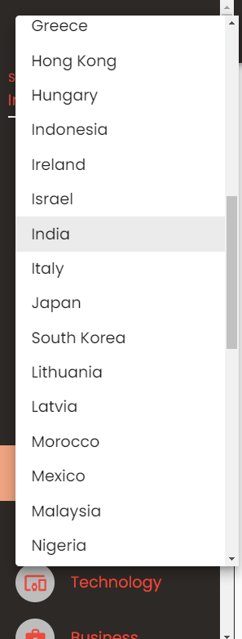
Select Countries
In this module the user can select their favourite country. Which Filters the country wise domain news,So that the user can view specific country news.
Rapid News | To Spread the news to multiply it

Slide 17
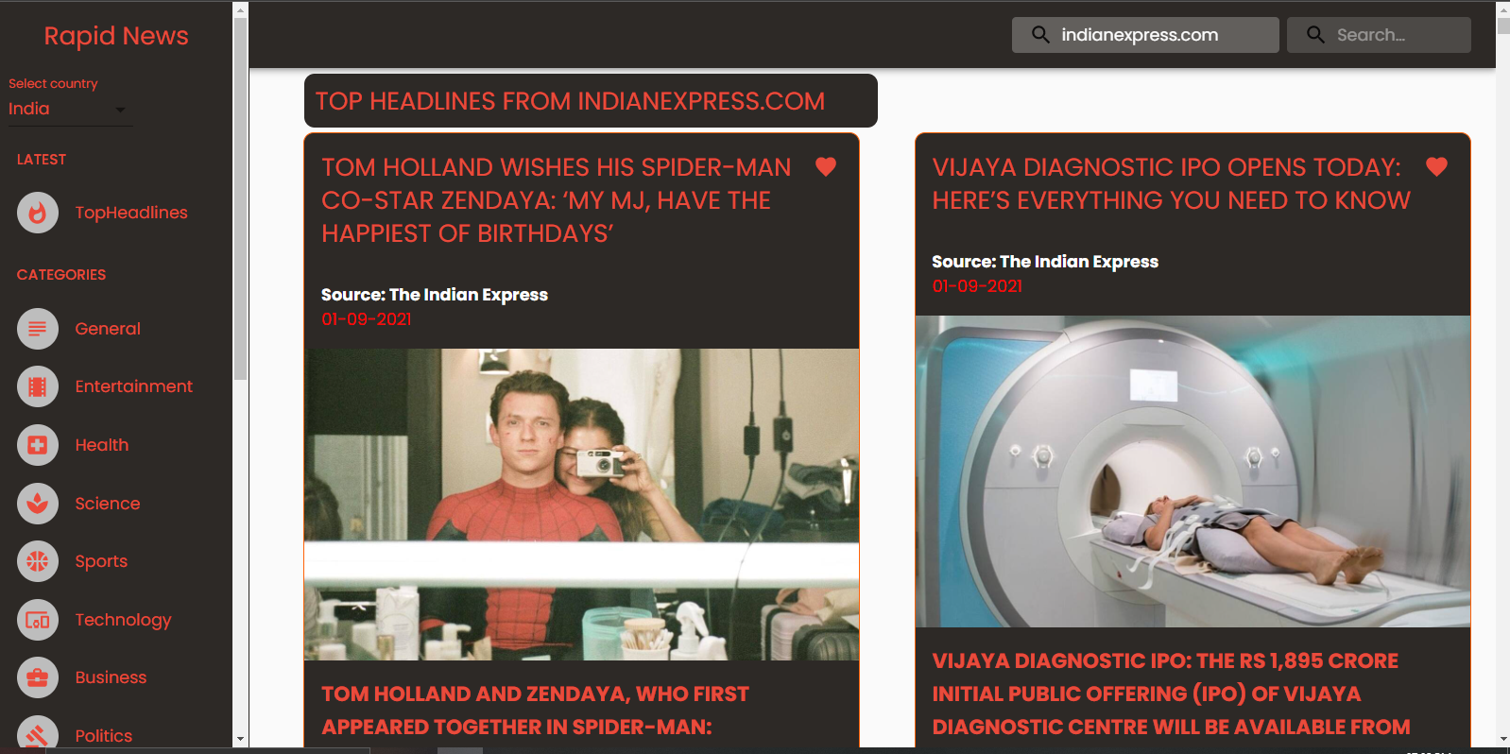
Domain Search Component
Domain Search options are a set of domains offered by News api. They Provide some of top domains in the world so that you can able to see the contents from the top domains web sites without even search them.
.
Rapid News | To Spread the news to multiply it

Slide 18
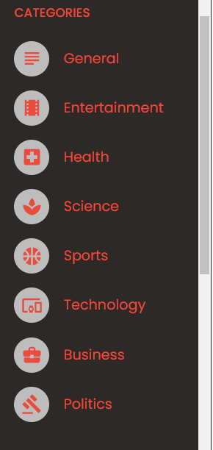
Select Categories
Categorizing a news indirectly assists in shaping the facts and the content of the news.News often have categories that overlap, such as Technology or Science and Business etc.
.
Rapid News | To Spread the news to multiply it.

Slide 19
DATA FLOW DIAGRAM
A data flow diagram shows the way information flows through a process or system.

Slide 20
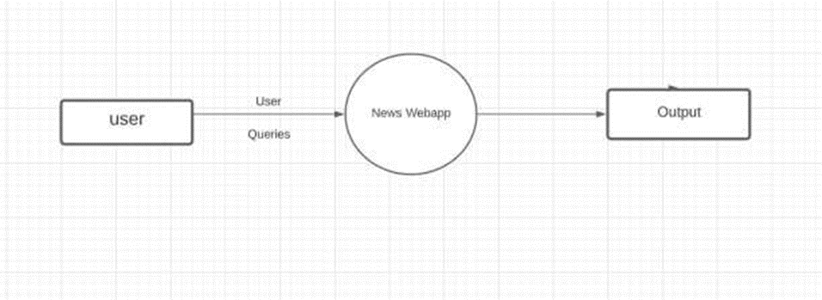
Data Flow Diagram
DFD LEVEL-0
Rapid News | To Spread the news to multiply it

Slide 21
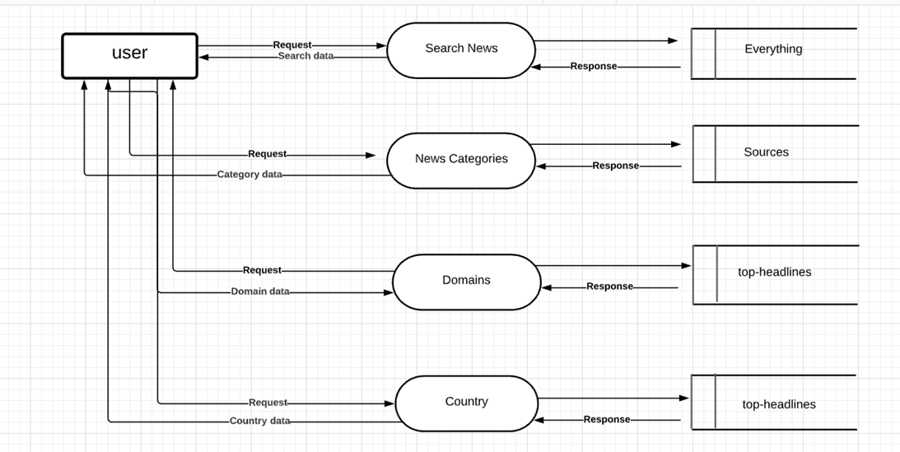
Data Flow Diagram
DFD LEVEL-1
Rapid News | To Spread the news to multiply it

Slide 22
Scope for Future Enhancement:-
In Future the likes and dislikes of every users can obtain and present it for everyone.
Also there will be the comments section so that the user can able to share their thoughts.
There will be a forum so that the people can post questions ,ideas and thoughts.
There will be also a login system for the users to maintain their own stuff .

Slide 23
Conclusion:-
The primary goal of the web-app is for offering global news from a different categories and domains.
Through this application any person who need to read news feeds can read on independent of time and language and share with others.
The user can able to save favourite news feed , it will be available in the favourites list every time.
This Site provides Short news for the rapid generation

Slide 24
THANK YOU

